Slide 1
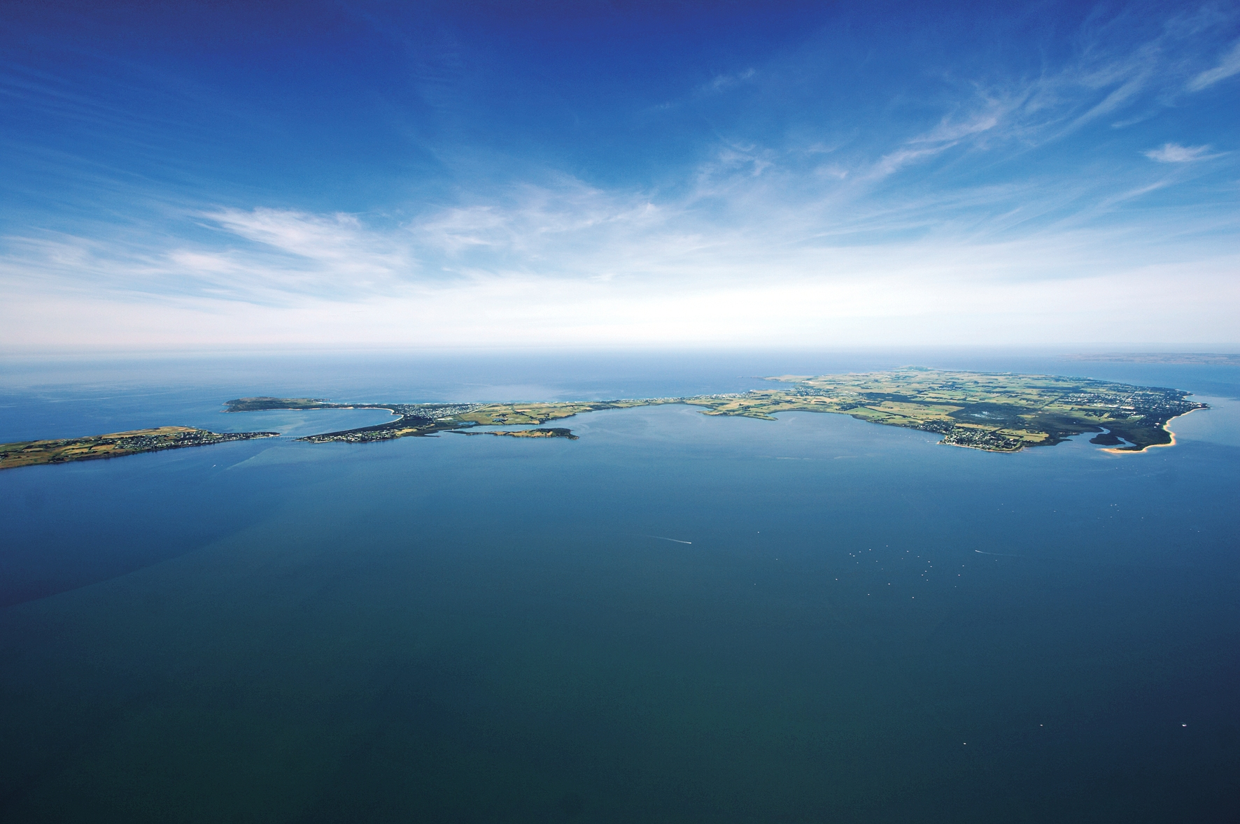
Phillip Island Aquatic Working Group

Slide 2
For over 25 years there have been community discussions about an aquatic centre on Phillip Island.
Many people consider an aquatic centre a ‘missing piece’ of community infrastructure.
The draft Sport and Active Recreation Needs Assessment confirms the desire for an aquatic centre for the Phillip Island community.

Slide 3
What has the Working Group Done?
Regular Meetings – monthly
Terms of Reference – previous & since 21 May 2014
Site Selection – four sites
Continuing review of similar Centres

Slide 4
Sites - Selection Matrix
Site 1 Cowes Recreation Reserve
Site 2 Hilton Chadwick Reserve
Site 3 Newhaven College
Site 4 Cowes Activity Centre

Slide 5
Site Selection Matrix
Process - two stages
Stage 1- Review four Key criteria
Size of site to meet development requirements
Public Transport Access
High Visibility of Site
Unsuitable Land
All key criteria to be met for a site to proceed to Stage 2

Slide 6
Site 1 – Cowes Recreation Reserve
X Site Size
X Public Transport
Access >500 metres
X High Visibility
✓ Unsuitable land

Slide 7
Site 2 – Hilton Chadwick Reserve
✓ Site Size – 16 Ha
X Public Transport
Access >500 metres
X High Visibility
Unsuitable land

Slide 8
Site 3 – Newhaven College
✓ Site Size
✓ Public Transport
Access <500 metres
✓ High Visibility
✓ Unsuitable land

Slide 9
Site 4 – Cowes Activity Centre
✓ Site Size
✓ Public Transport
Access <500 metres
✓ High Visibility
✓ Unsuitable land

Slide 10
Site Selection Matrix - Stage 2
Stage 2 – Site Selection 12 criteria were scored 1-10
Criterion 5 Planning/Zoning
Criterion 6 Site Services
Criterion 7 Site Access and Traffic Impacts
Criterion 8 Value of Site
Criterion 9 Passing Traffic
Criterion 10 Location to Catchment Population

Slide 11
Site Selection Matrix
Stage 2 – Site Selection 12 criteria were scored 1-10
Criterion 11Neighbourhood Effects
Criterion 12 Compatible use of Site
Criterion 13 Image of site
Criterion 14 Shared Development opportunities
Criterion 15 Potential of part land sale or lease
Criterion 16 Commercial potential of site

Slide 12
Site Selection Matrix Summary
Assessment of the two sites take through to stage 2
Cowes Activity Centre (score 88)
Newhaven College (score 72)

Slide 13
Terms of Reference
Functions
Undertake investigation to determine the most appropriate first stage of construction of the Phillip Island Aquatic Centre
Investigate available funding options through community fundraising and/or government grants
Work with the community to identify needs requirements of user groups to be considered in the design
Identify examples of world best practice of operational swimming pool design elements that can be incorporated to reduce operating costs
Work with other agencies to undertake and investigate the best overall use the site
Outcomes
Produce a report for presentation to Council with agreed outcomes from the various functions above with a target date of June 2015
Increased engagement between Council and the Community
Providing advice to Council to help achieve Council’s Strategic Objectives
Provide advice towards the development of a concept plan that reflects world best practice
Additional functions and outcomes in red
JK/HS

Slide 14
What next?
Prepare Brief for the development of a Concept Plan
Alignment to Cowes Activity Plan as part of an Integrated Plan
Compile supporting information for funding applications
Keep funding bodies aware of the project planning
Monitor other Aquatic Centre developments taking place
Consult stakeholders

Slide 15
Council Meeting 16th Sept 2015
Item E9
Ratified Cowes Activity Centre Plan (Part of 50-54 Church St Cowes) as preferred site for the future development of an Aquatic Centre on Phillip Island.
Undertakes a detailed assessment of the site to confirm its suitability for the future development of an aquatic facility.
Undertakes the development of a concept plan for the site.
Amends the Terms of Reference for the Phillip Island Aquatic Working Group to include Functions and Outcomes as set out in this report.
Council moved :- That the recommendations be adopted - Carried

Slide 16
Next step
Otium Planning was appointed and Peddle Thorp Architect were engaged to design a concept plan.
They produced a business case.
The only concern was could a transport hub fit on the block so GTA Traffic consultants were engaged and established that 213 spaces could be available plus room for a bus terminal as well.
Government funding is based on the feasibility studies carried out during the earlier work to establish an aquatic centre.
After checking with Sports and Recreations Victoria while they say you could request funding for a large facility they will only fund for what was in the feasibility study.

Slide 18
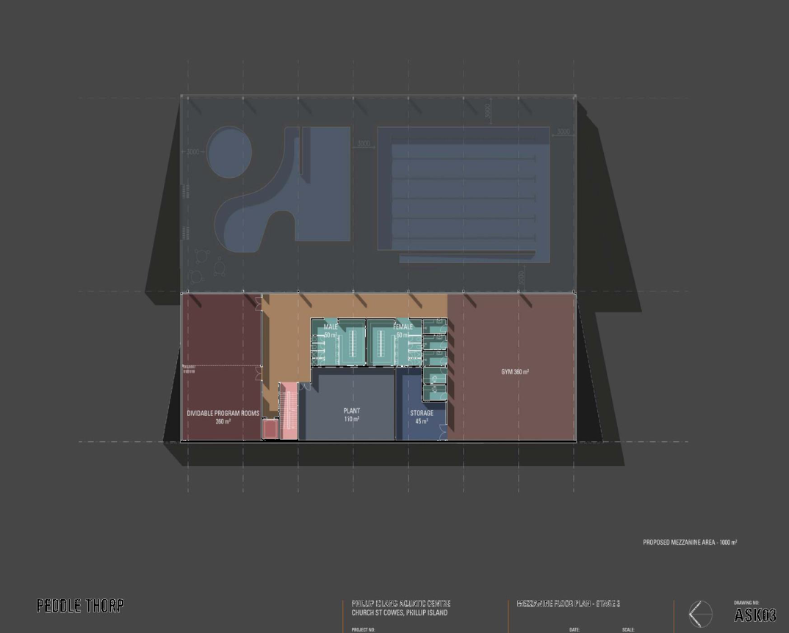

Slide 19
Council meeting 15th March 2017
Without any discussion of the Officer’s recommendation. A Motion was put and carried to not locate the Phillip Island Aquatic Centre on part of lot 56 – 60 Church Street Cowes.
And consider a suitable site for the Phillip Island Aquatics Centre after they receive briefing of Bass Coast Shire Council’s Property Strategy on 31 May 2017.

Slide 20
Where to from here??
1st Working Group 2012 – Jan 20, March 23, June 15 and July 13.
Second attempt to form a working group failed the only meeting was Oct 13 2014. Is Friday the 13th an omen not to continue.

Slide 21
Concept Design Process
Complete a two phase design process – phase one detailed site assessment & phase two – Concept Design
Funding Application requirements
Full developed concept plan – (ready to proceed to full design process) – also need to involve advisors from funding bodies in the process
Developed costing (QS) based on the concept plan
Business Plan/Operational budget based on the final concept plan (still to be done)
HS

